Slide 1
BZ350 Recitation Week 14
T.A. info:
Chris deRoux (day-ROO)
Any/all pronouns
Chris.deRoux@colostate.edu
Office Hours: Every Friday 10AM-12PM in Bio 355
Itinerary:
Announcements
Genetics in the News
Eukaryotic Regulation Review
Sample Problem

Slide 2
Announcements
Problem Set 13: Due Mon 4/29 at 9am.
Exam 3: I still have no idea when you’ll get it back. Grades look good.
Recitation Participation: If you see a 0 for a week you were definitely here, let me know on Canvas or by email and I’ll fix it.

Slide 3
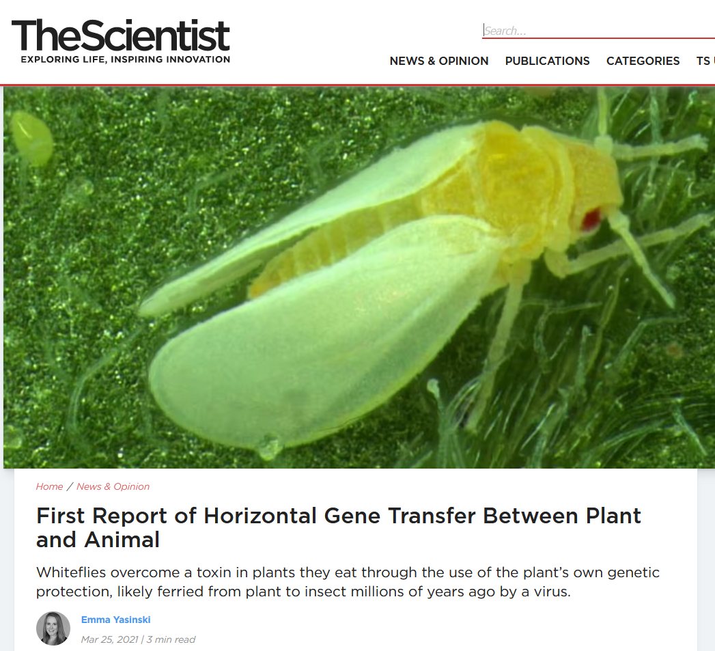
Genetics in the News!

Slide 4
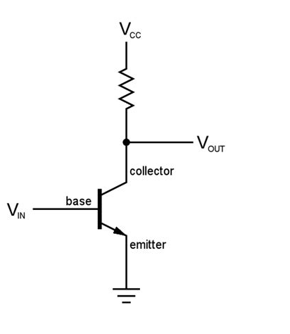
The lac operon and cAMP
The lac operon can be induced by the presence of cyclic AMP (cAMP).
cAMP is bacterial stress signal produced in high quantities when glucose is low/absent.
cAMP binds to the Catabolite Activator Protein (CAP), which recruits Pol II to the promoter.
Similar in function to eukaryotic transcription factors, as opposed to operator induction/repression.

Slide 5
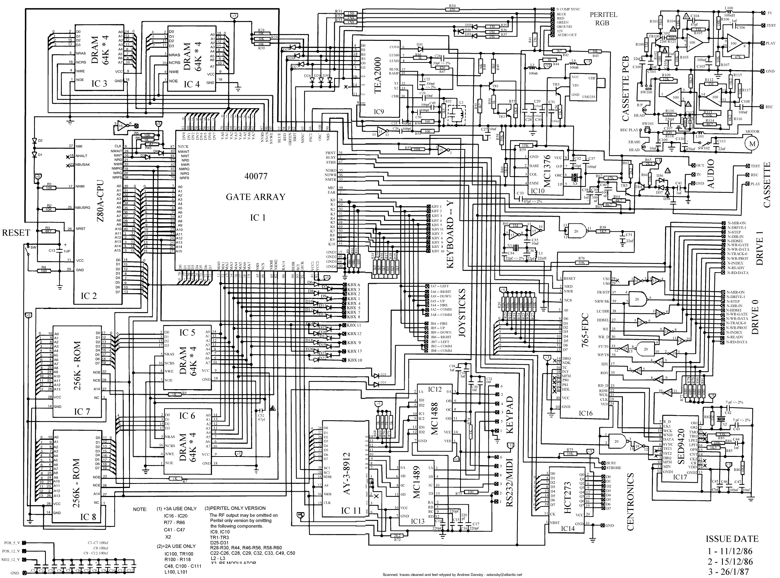
Eukaryotic Regulation Review
Eukaryotes regulate gene expression at every stage of the central dogma: DNA sequence accessibility, transcription, and translation.
Gene expression can be prevented, stopped midway, or its products can be degraded at any stage.
In multicellular eukaryotes, intercellular signals called hormones can up/down-regulate gene expression.

Slide 6
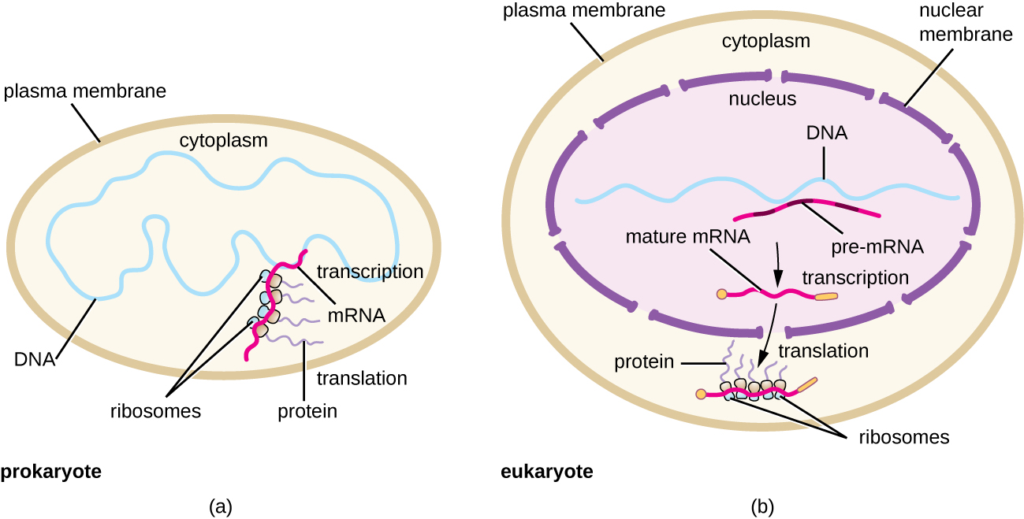
What explains this jump in complexity?

Slide 7
What explains this jump in complexity? The nucleus and cell size.

Slide 8
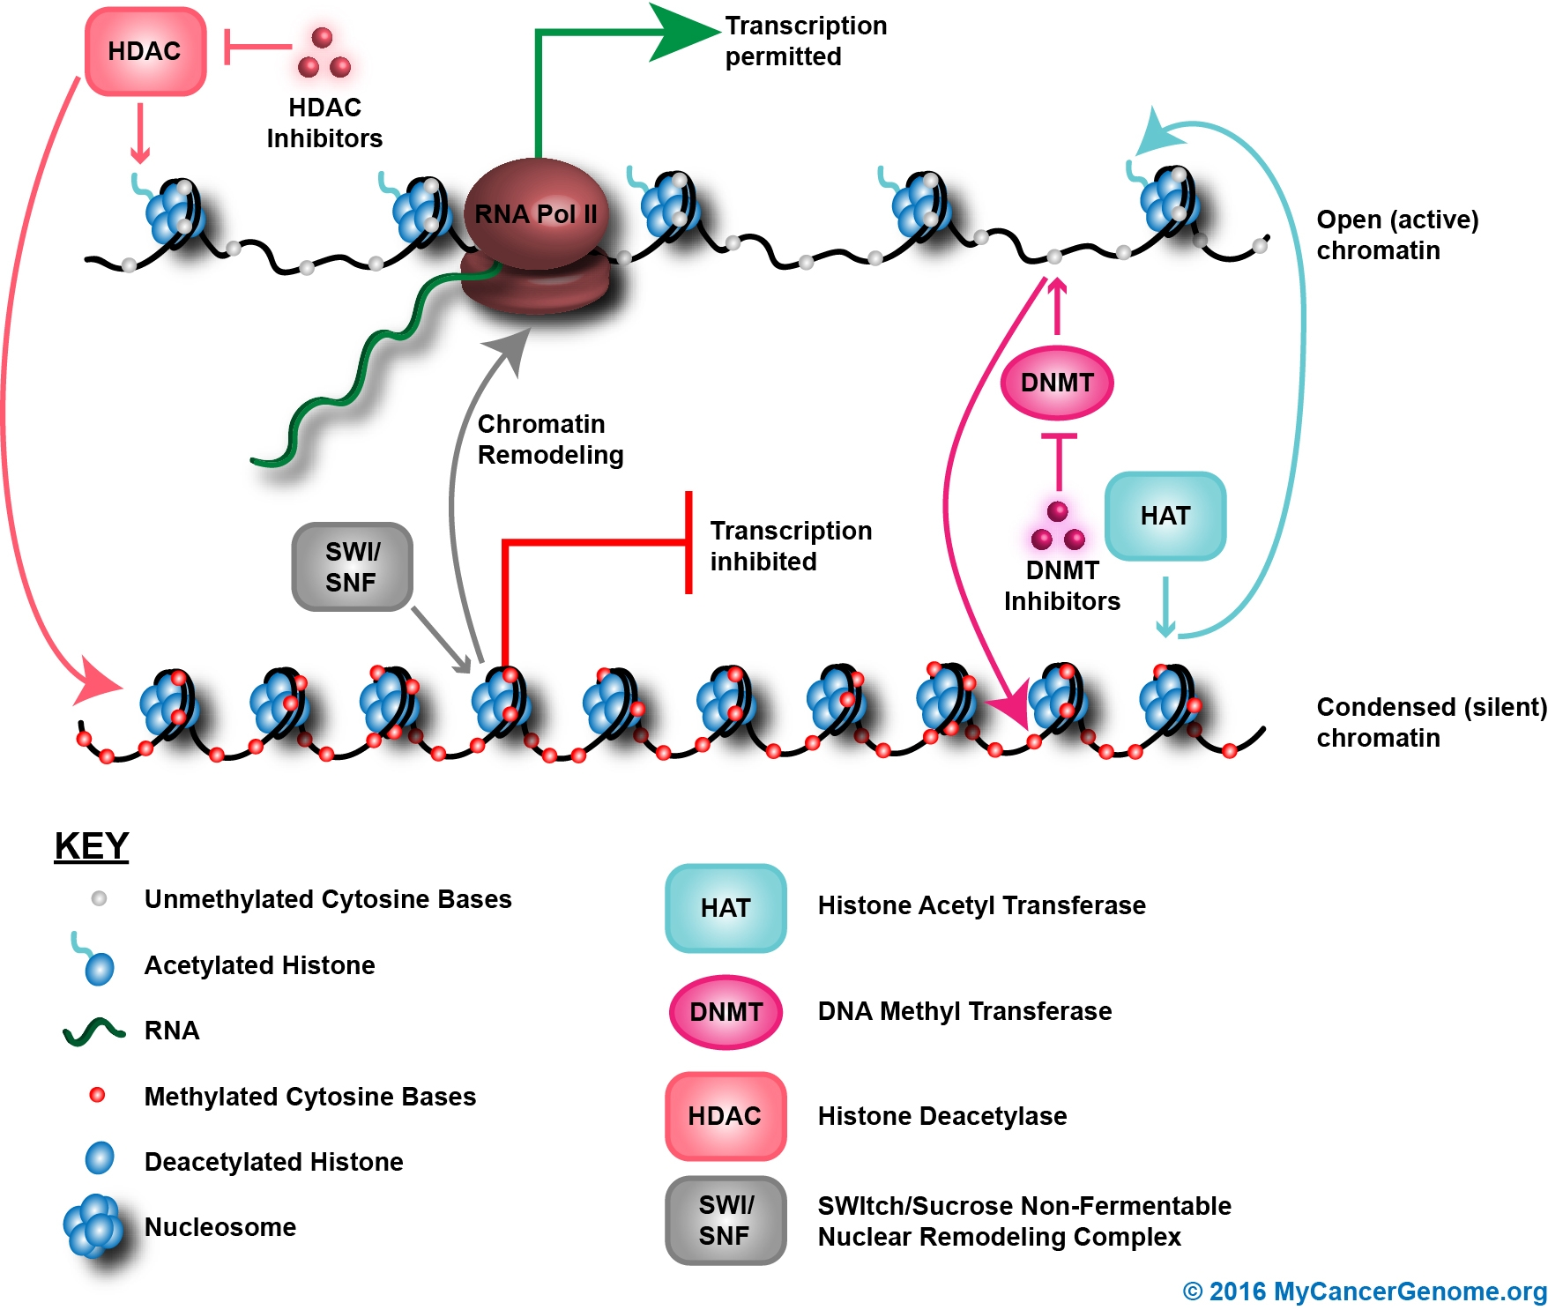
Also, chromatin!
Chromatin is a complex of DNA and proteins, only found in eukaryotes (and archaea.)
Histone proteins gather in cluster of 8 to form nucleosomes, which wrap two loops of DNA around them.
Histones have “tails” of amino acids which can be modified to alter the spacing of nucleosomes.
Nucleosome spacing can inhibit or outright block transcription.

Slide 9
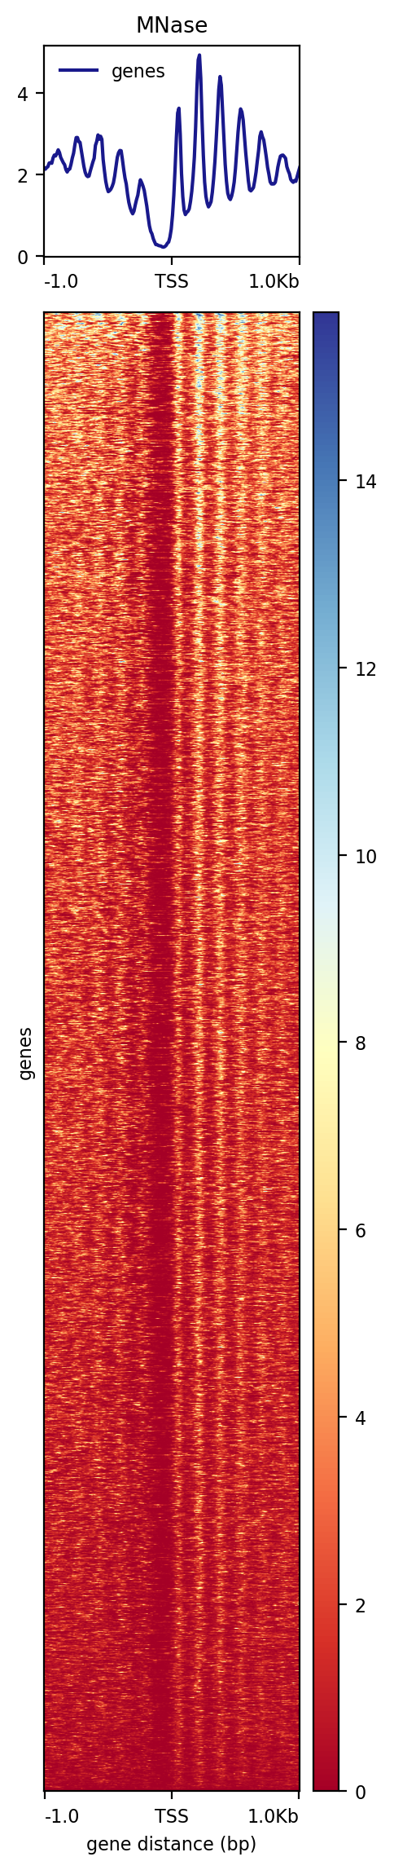
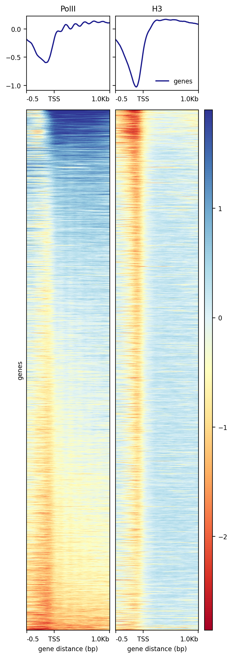
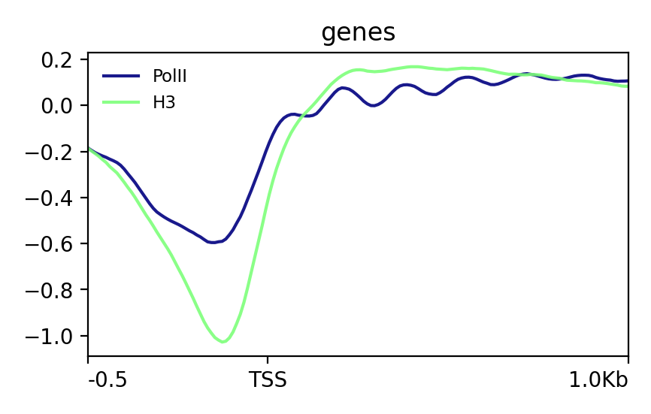
Yeast Nucleosomes and Pol II

Slide 10
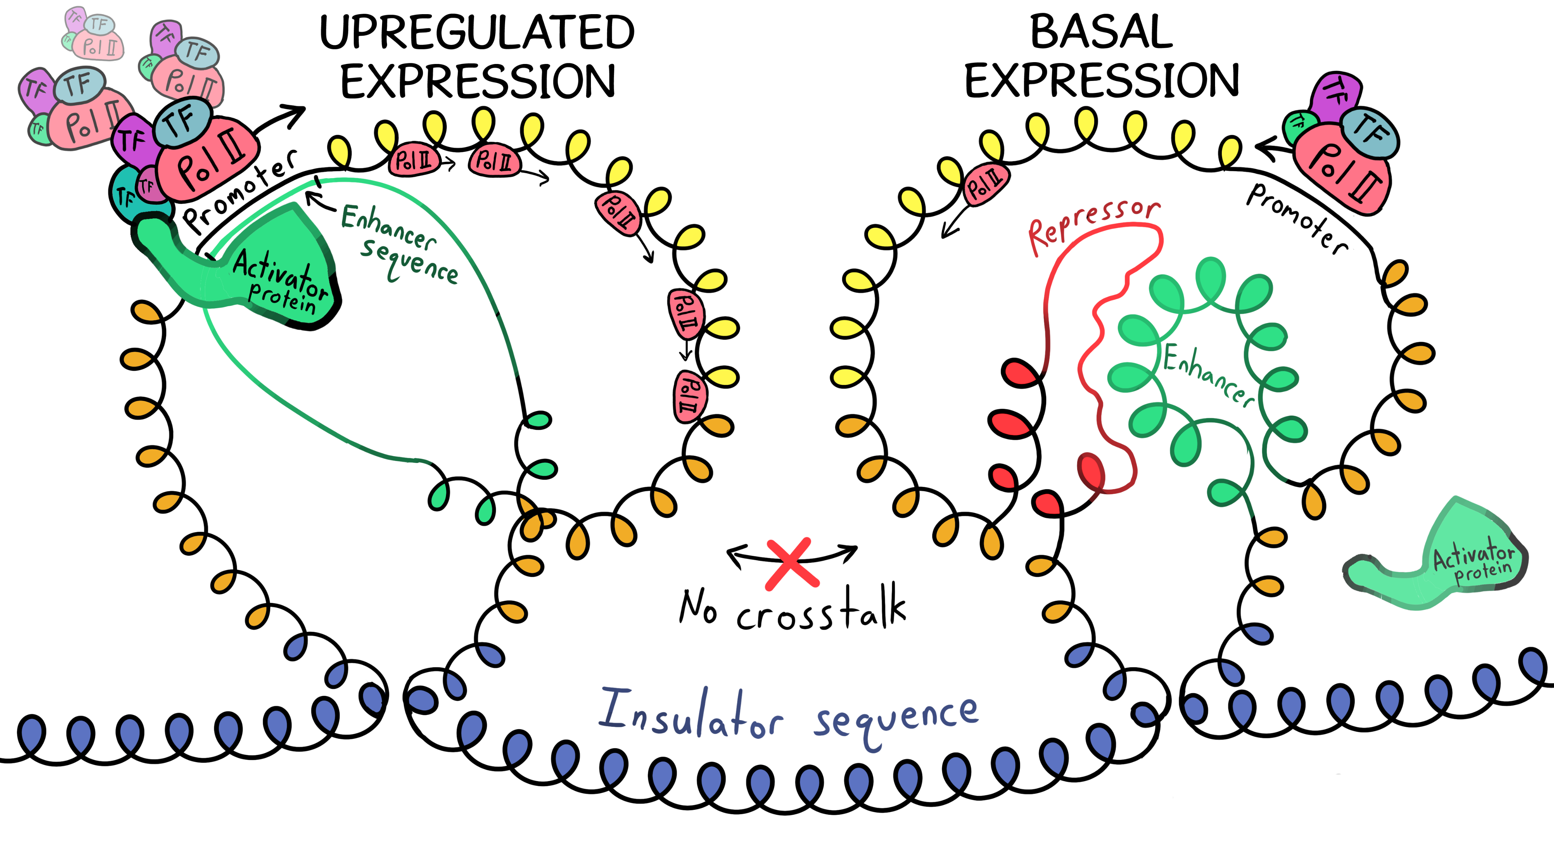
Enhancers, Repressors, and Insulators

Slide 11
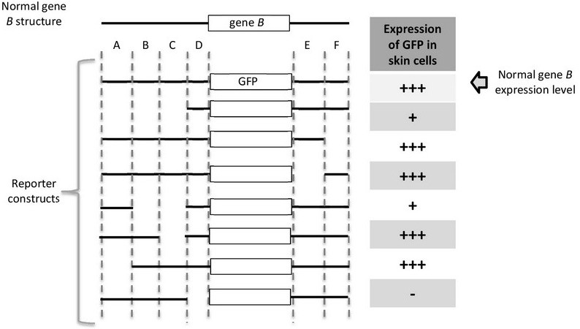
Gene B is highly expressed in skin cells. To identify the sequence elements (cis-elements) that regulate the expression of gene B, you joined different parts of upstream and downstream genomic DNA regions of gene B (black lines, full or parts of A to F) to a GFP reporter (i.e., the coding region of GFP) as shown in the figure below. These different DNA fusions (reporter fusions) were introduced into skin cells growing in the lab by transfection, and the level of GFP expression was monitored by measuring green fluorescence. The table below shows relative GFP expression, with more +’s equal to more expression. (one + = basal expression).

Slide 12
Gene B is highly expressed in skin cells. To identify the sequence elements (cis-elements) that regulate the expression of gene B, you joined different parts of upstream and downstream genomic DNA regions of gene B (black lines, full or parts of A to F) to a GFP reporter (i.e., the coding region of GFP) as shown in the figure below. These different DNA fusions (reporter fusions) were introduced into skin cells growing in the lab by transfection, and the level of GFP expression was monitored by measuring green fluorescence. The table below shows relative GFP expression, with more +’s equal to more expression. (one + = basal expression).
Which area contains the gene B
promoter?
A) A
B) B
C) C
D) D
E) E
F) F

Slide 13
Gene B is highly expressed in skin cells. To identify the sequence elements (cis-elements) that regulate the expression of gene B, you joined different parts of upstream and downstream genomic DNA regions of gene B (black lines, full or parts of A to F) to a GFP reporter (i.e., the coding region of GFP) as shown in the figure below. These different DNA fusions (reporter fusions) were introduced into skin cells growing in the lab by transfection, and the level of GFP expression was monitored by measuring green fluorescence. The table below shows relative GFP expression, with more +’s equal to more expression. (one + = basal expression).
Which area contains the gene B
promoter?
A) A
B) B
C) C
D) D
E) E
F) F
Without this sequence, there is no transcript expressed at all

Slide 14
Gene B is highly expressed in skin cells. To identify the sequence elements (cis-elements) that regulate the expression of gene B, you joined different parts of upstream and downstream genomic DNA regions of gene B (black lines, full or parts of A to F) to a GFP reporter (i.e., the coding region of GFP) as shown in the figure below. These different DNA fusions (reporter fusions) were introduced into skin cells growing in the lab by transfection, and the level of GFP expression was monitored by measuring green fluorescence. The table below shows relative GFP expression, with more +’s equal to more expression. (one + = basal expression).
Which area(s) is/are likely to contain a
cis-acting regulatory element?
A) A
B) B
C) C
D) D
E) E
F) F

Slide 15
Gene B is highly expressed in skin cells. To identify the sequence elements (cis-elements) that regulate the expression of gene B, you joined different parts of upstream and downstream genomic DNA regions of gene B (black lines, full or parts of A to F) to a GFP reporter (i.e., the coding region of GFP) as shown in the figure below. These different DNA fusions (reporter fusions) were introduced into skin cells growing in the lab by transfection, and the level of GFP expression was monitored by measuring green fluorescence. The table below shows relative GFP expression, with more +’s equal to more expression. (one + = basal expression).
Which area(s) is/are likely to contain a
cis-acting regulatory element?
A) A
B) B
C) C
D) D
E) E
F) F
B likely is a cis-enhancer D likely is a cis-promoter

Slide 16
Gene B is highly expressed in skin cells. To identify the sequence elements (cis-elements) that regulate the expression of gene B, you joined different parts of upstream and downstream genomic DNA regions of gene B (black lines, full or parts of A to F) to a GFP reporter (i.e., the coding region of GFP) as shown in the figure below. These different DNA fusions (reporter fusions) were introduced into skin cells growing in the lab by transfection, and the level of GFP expression was monitored by measuring green fluorescence. The table below shows relative GFP expression, with more +’s equal to more expression. (one + = basal expression).
Which area is likely to bind to proteins that activate gene B (an
activator)?
A) A
B) B
C) C
D) D
E) E
F) F

Slide 17
Gene B is highly expressed in skin cells. To identify the sequence elements (cis-elements) that regulate the expression of gene B, you joined different parts of upstream and downstream genomic DNA regions of gene B (black lines, full or parts of A to F) to a GFP reporter (i.e., the coding region of GFP) as shown in the figure below. These different DNA fusions (reporter fusions) were introduced into skin cells growing in the lab by transfection, and the level of GFP expression was monitored by measuring green fluorescence. The table below shows relative GFP expression, with more +’s equal to more expression. (one + = basal expression).
Which area is likely to bind to proteins that activate gene B (an
activator)?
A) A
B) B
C) C
D) D
E) E
F) F
Binds to a protein that activates the gene because without B, there is minimal expression. However, with B there is full expression

